Slide 1
Artificial Intelligence Production Base System
unknown
RL
known
deterministic
stochastic
atomic
SEARCH
MDPs
factored
LOGIC
Bayes nets
structured
First-order logic

Slide 2
Outline
Introduction
Components
Architecture
Inference
Forward Chaining
Backward Chaining
Problems with the Recognize-Act Cycle
Rete Matching Algorithm

Slide 3
Production Based System
Oldest techniques of knowledge representation
System consists:
Knowledge base: represented by production rules
Working memory: hold the matching patterns of data that causes the rules to fire
Interpreter (inference engine): decides which rule to fire, when more than one of them are concurrently firable
Rule firing causes:
New consequences are added to the working memory
Old and unnecessary consequences of previously fired rules are dropped out from the working memory

Slide 4
Production Rule
Production Rule:
PR1: Mother(m, c) ⇒ Loves(m, c)
Rule Maps: a mother-child relationship between (m, c) to a love relationship between the same pair
Rule implicates: if “m” is a mother of child “c” then “m” loves “c”
Production Rule Structure:
PR1: P₁(x) Λ P₂(y) Λ .. P_{n}(x, z) ⇒ Q₁(y) V Q₂(z) V .. Q_{m}(y, x)
P_{i} and Q_{i} are predicantes
x, y, z are variables
Λ and V are logical AND, OR
⇒ if-then operators
Antecedent / Condition
consequent / conclusion
need not be always predicates
object-attribute-value

Slide 5
Example
PR2 : if (person age above-21) &
(person wife nil) &
(person gender male)
then (person eligible for marriage)
PR3: if (Ram age 25) &
(Ram wife nil) &
(Ram gender male)
then (Ram eligible for marriage).
More General Rule
More Specific Rule

Slide 6
The Working Memory (WM)
WM holds data either in the form
Clauses : Mother(Rajmata_Jijabai, Chha. Shivaji)
Object-attribute-value (OAV) : Rajmata_Jijabai Spouse Shahaji

Slide 7
The Working Memory (WM)
WM
Mother(Rajmata_Jijabai, Chha. Shivaji)
Spouse(Rajmata_Jijabai, Shahaji)
Knowledge Base
PR1: Spouse(x, y) Λ Mother(x, z) ⇒ Father(y, z)
Interpreter
Match the variables
Decide rule to fire
Add: Father(Shahaji, Chha. Shivaji)

Slide 8
Interpreter / Inference Engine
Passes through three step recognize-act cycle
Match
Decide
Act
Add new data to WM or delete old (and unnecessary) data, as suggested by the fired rule from the WM
Match the variables of the antecedents of a rule, kept in a knowledge base, with the data recorded in the WM.
Decide which rule to fire by designing a set of strategies for resolving the conflict regarding firing of the rules.

Slide 9
Conflict Resolution Process
Identifying which rule to fire.
Design a Rule-Set:
Deterministic: construct a rule-set where only one rule is firable at any instant of time
Non-deterministic: in real world contain, where more than one rule is firable at any instant of time.
Performance: depends on
Sensitive: if the system can respond quickly to the change in environment, reflected by the new contents of the WM.
Stability: showing continuity in the line of reasoning.

Slide 10
Example
Problem: sorting a string composed of the letters a, b, and c.
Working memory: cbaca
Production Rule set:
ba ⇒ ab
ca ⇒ ac
cb ⇒ bc

Slide 11
Trace of production System
WM: cbaca Production Rule set:
ba ⇒ ab
ca ⇒ ac
cb ⇒ bc
Iteration | WM | Conflict Set | Rule Fired
1 | cbaca | 1, 2, 3 | 1
2 | cabca | 2 | 2
3 | acbca | 3, 2 | 2
4 | acbac | 1, 3 | 1
5 | acabc | 2 | 2
6 | aacbc | 3 | 3
7 | aabcc | Ø | Halt

Slide 12
Conflict Resolution Strategies
Refractoriness:
The same rule should not be fired more than once.
Recency:
Uses most recent elements of the WM for instantiating one of the rules.
Specificity:
The rule with more number of condition clauses be fired.
KB: WM:
PR1: Bird(x) → Fly(x) Bird(parrot),
PR2: Bird(x), Not emu(x) → Fly(x) Not emu(parrot)
The second rule should be fired

Slide 13
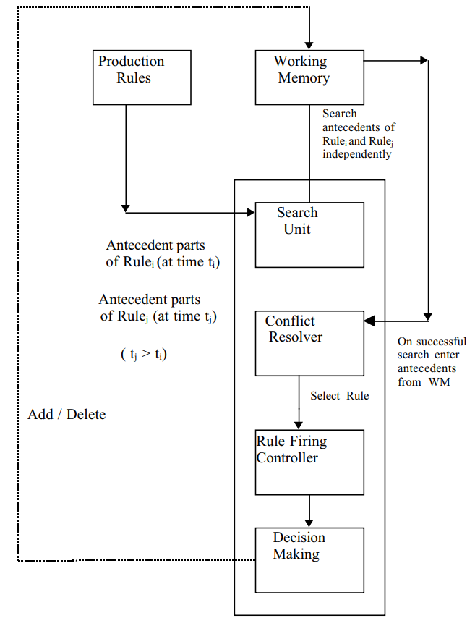
Architecture
Production Rules
Working Memory
Control Unit / Interpreter
Search Unit
Conflict Resolver
Rule Firing Controller
Decision Making

Slide 14
Inference Procedure
Forward Chaining
Data-driven inference
Starting from the current state
Matching the condition of the rules (the IF parts)
Performing the corresponding actions (the THEN parts)
Update the WM
Backward Chaining
Goal-driven inference:
looking at the WM to see if the sub-goal states already exist there.
If not, the actions (the THEN parts) of the rules that will establish the sub-goals are identified
new sub-goals are set up for achieving the premises of those rules (the IF parts).

Slide 15
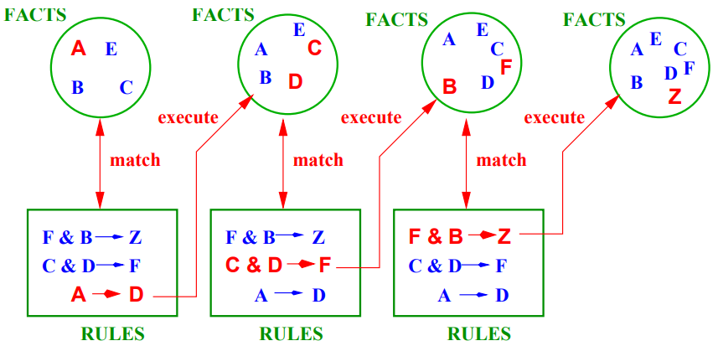
Forward Chaining
The process continues until no more rules can be applied, or some cycle limit is met

Slide 16
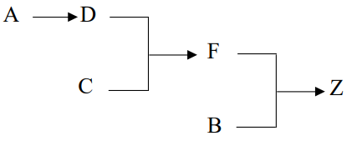
The Forward Inference Chain
In this example there are no more rules, so we can draw the inference chain:
This seems simple enough, but in this case we only had a few initial facts, and a few rules
Generally, things will not be so straight forward.
Disadvantages:
Many rules may be applicable at each stage – so how should we choose which one to apply next at each stage?
The whole process is not directed towards a goal, so how do we know when to stop applying the rules?

Slide 17
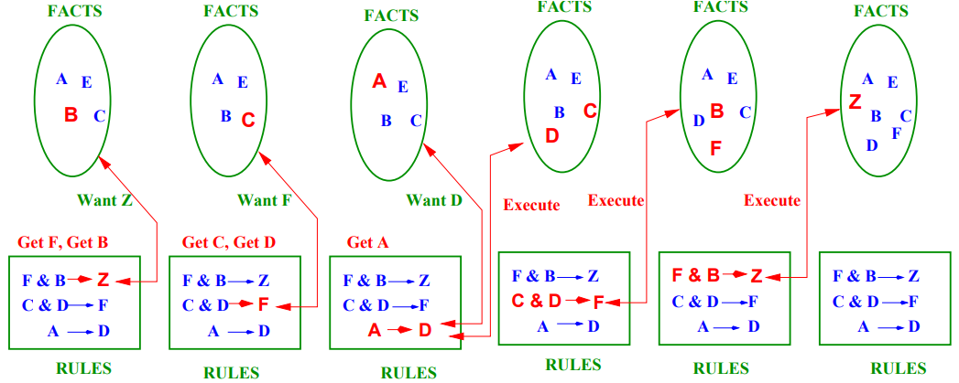
Backward Chaining

Slide 18
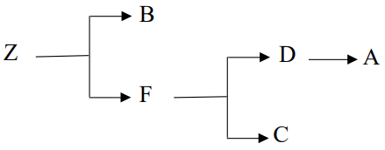
The Backward Inference Chain
The first part of the chain works back from the goal until only the initial facts are required, at which point we know how to traverse the chain to achieve the goal state.
Advantage:
The search is goal directed, so we only apply the rules that are necessary to achieve the goal.
Disadvantage
A goal has to be known. Fortunately, most AI systems we are interested in can be formulated in a goal based fashion.

Slide 19
Example
Production Rules:
PR1: IF the ignition key is on
AND the engine won’t start
THEN the starting system (including battery) is faulty
PR2: IF the starting system (including battery) is faulty
AND the headlights work
THEN the starter is faulty
PR3: IF the starting system (including battery) is faulty
AND the headlights not work
THEN the battery is dead
PR4: IF the voltage test on the ignition switch shows 1 to 6 volts
THEN the wiring between the ignition and the solenoid is OK
PR5: IF the wiring between the ignition and the solenoid is OK
THEN replace the ignition switch
WM:
The ignition key is on
The engine won’t start
The headlights work
The voltage test on the solenoid shows 1 to 6 volts

Slide 20
Example
Production Rules:
PR1: IF the ignition key is on
AND the engine won’t start
THEN the starting system (including battery) is faulty
PR2: IF the starting system (including battery) is faulty
AND the headlights work
THEN the starter is faulty
PR3: IF the starting system (including battery) is faulty
AND the headlights not work
THEN the battery is dead
PR4: IF the voltage test on the ignition switch shows 1 to 6 volts
THEN the wiring between the ignition and the solenoid is OK
PR5: IF the wiring between the ignition and the solenoid is OK
THEN replace the ignition switch
WM:
A: The ignition key is on
B: The engine won’t start
C: The headlights work
D: The voltage test on the solenoid shows 1 to 6 volts

Slide 21
Example
Production Rules:
PR1: IF the ignition key is on
AND the engine won’t start
THEN the starting system (including battery) is faulty
PR2: IF the starting system (including battery) is faulty
AND the headlights work
THEN the starter is faulty
PR3: IF the starting system (including battery) is faulty
AND the headlights not work
THEN the battery is dead
PR4: IF the voltage test on the ignition switch shows 1 to 6 volts
THEN the wiring between the ignition and the solenoid is OK
PR5: IF the wiring between the ignition and the solenoid is OK
THEN replace the ignition switch
PR1: A ∧ B ⇒ E
PR2: E ∧ C ⇒ G
PR3: E ∧ ~C ⇒ I
PR4: D ⇒ F
PR4: F ⇒ H

Slide 22
Example – Forward Chaining
Production Rules:
PR1: A ∧ B ⇒ E
PR2: E ∧ C ⇒ G
PR3: E ∧ ~C ⇒ I
PR4: D ⇒ F
PR5: F ⇒ H
WM:
A
B
C
D
Goal:
Infer all possible Facts
Conflict Resolution Strategy:
Refractoriness
Iteration | WM | Conflict Set (Queue) | Rule Fired | Action
1 | ABCD | 1, 4 | 1 | PR1 add E
2 | ABCDE | 4, 2 | 4 | PR1 is no longer applicable, PR4 add F
3 | ABCDEF | 2, 5 | 2 | PR4 is no longer applicable, PR2 add G
4 | ABCDEFG | 5 | 5 | PR2 is no longer applicable, PR5 add H
5 | ABCDEFGH |  |  | No applicable rules (all are used!)

Slide 23
Example – Backward Chaining
Production Rules:
PR1: A ∧ B ⇒ E
PR2: E ∧ C ⇒ G
PR3: E ∧ ~C ⇒ I
PR4: D ⇒ F
PR5: F ⇒ H
WM:
A
B
C
D
Goal:
H ∧ I
Conflict Resolution Strategy:
Refractoriness
Iteration | WM | Conflict Set | Rule Fire | Action
1 | ABCD | 5 (F Not in WM), 4 (D in WM) | 4 | PR4 add F
2 | ABCDF | 5 (F in WM) | 5 | PR5 add H
3 | ABCDFH | 3 (E and ~C Not in WM), 1 (A and B in WM) | 1 | PR1 add E
4 | ABCDFHE | 3 (~C Not in WM), |  | I is not supported, H ∧ I rejected

Slide 24
Example2 – Forward Chaining
Production Rules:
PR1: P ∧ Q ⇒ GOAL
PR2: R ∧ S ⇒ P
PR3: W ∧ R ⇒ P
PR4: T ∧ U ⇒ P
PR5: V ⇒ S
PR6: START ⇒ V ∧ R ∧ Q
WM:
START
Goal:
P ∧ Q ⇒ GOAL
Conflict Resolution Strategy:
Choose rule that has fired least recently

Slide 25
Example2 – Forward Chaining
Production Rules:
PR1: P ∧ Q ⇒ GOAL
PR2: R ∧ S ⇒ P
PR3: W ∧ R ⇒ P
PR4: T ∧ U ⇒ P
PR5: V ⇒ S
PR6: START ⇒ V ∧ R ∧ Q
WM:
START
Goal:
P ∧ Q ⇒ GOAL
Conflict Resolution Strategy:
Choose rule that has fired least recently
Iteration | WM | Conflict Set | Rule Fired | Action
1 | START | 6 | 6 | PR6 add V, R, Q
2 | START, V, R, Q | 6, 5 | 5 | PR5 add S
3 | START, V, R, Q, S | 6, 5, 2 | 2 | PR2 add P
4 | START, V, R, Q, S, P | 6, 5, 2, 1 | 1 | PR5 add H
5 | START, V, R, Q, S, P, GOAL | 6, 5, 2, 1 | Halt | Stop

Slide 26
Example2 – Backward Chaining
Production Rules:
PR1: P ∧ Q ⇒ GOAL
PR2: R ∧ S ⇒ P
PR3: W ∧ R ⇒ P
PR4: T ∧ U ⇒ P
PR5: V ⇒ S
PR6: START ⇒ V ∧ R ∧ Q
WM:
START
Goal:
P ∧ Q ⇒ GOAL
Conflict Resolution Strategy:
Choose rule that has fired least recently
Iteration | WM | Conflict Set | Rule Fired | Action
1 | GOAL | 1 | 1
2 | GOAL, P, Q | 1, 2, 3, 4 | 2
3 | GOAL, P, Q, R, S | 1, 2, 3, 4, 5 | 3
4 | GOAL, P, Q, R, S, W | 1, 2, 3, 4, 5 | 4
5 | GOAL, P, Q, R, S, W, T, U | 1, 2, 3, 4, 5 | 5
6 | GOAL, P, Q, R, S, W, T, U, V | 1, 2, 3, 4, 5, 6 | 6
7 | GOAL, P, Q, R, S, W, T, U, V, START | 1, 2, 3, 4, 5, 6 | Halt

Slide 27
Interpreter / Inference Engine
Passes through three step recognize-act cycle
Match
Decide
Act
Add new data or delete old to WM
Match the rule antecedent variables with WM elements.
Decide which rule to fire from conflict set

Slide 28
Problems with the Recognize-Act Cycle
How do we know that our production system is Consistent?
We need a Reason Maintenance System
How do we know which Global Strategy for rule choice to apply?
We need to choose between Forward and Backward Chaining
How do we know which Local Strategy for rule choice to apply?
We need a Conflict Resolution System
How do we Maximize Efficiency as the Complexity increases?
We can use the Rete Match Algorithm

Slide 29
Reason Maintenance System
PR1: IF Raining ∧ Outside ∧ ¬Has_Umbrella
THEN Wet
Facts in WM: Dry, Outside, Raining
Rule to generate a new fact: Dry, Outside, Raining, Wet
This is now an inconsistent set of facts.
Reason Maintenance System requires into our system to deal with the inconsistencies.

Slide 30
Forward or Backward Reasoning?
Are there more possible start states or goal states?
Do we require the system to justify its reasoning?
Prefer the direction that corresponds more closely with the way that users think.
What kind of events trigger problem solving?
If it is the arrival of a new fact, then forward chaining makes sense.
If it is a query to which a response is required, then backward chaining will be more natural.
In which direction is the branching factor greatest?
Go in the direction with the lower branching factor.

Slide 31
Conflict Resolution
1. Match the rules against the known facts to see which rules can fire.
2. If more than one rule can fire, use a Conflict Resolution strategy to choose one.
3. Fire the chosen rule, updating the list of known facts.
4. Check the Termination Criterion and either stop or return to step 1.
Conflict Resolution: can dramatically affect the solution
Category
General conflict resolution
Problem specific conflict resolution.

Slide 32
General Conflict Resolution Strategies
Five most common strategies are:
Delete instantiations of rules that have already fired.
Prevents obvious endless loops of the same rules
Order instantiations by the generation age of all the elements. Prefer the youngest.
New elements are more likely to describe the current situation.
Compare the generation age of the elements in working memory which match the first condition of the rules. Prefer the youngest.
As for strategy 2, but may be more efficient.
Prefer the most specific rules (i.e. those with the most pre-conditions).
This catches any exceptions/special cases before applying more general rules.
Random choice.
Very easy to compute.

Slide 33
Specific Conflict Resolution Example
Consider the following set of rules:
PR1: IF: engine does not turn AND battery is not flat
THEN: ask user to test starter motor
PR2: IF: there is no spark
THEN: ask user to check the points
PR3: IF: engine turns AND engine does not start
THEN: ask user to check the spark
PR4: IF: engine does not turn
THEN: ask user to check the battery
PR5: IF: battery is flat
THEN: ask user to charge battery AND EXIT
WM: “engine does not turn” and “battery is not flat”
The conflict set is: { 〈 R1, engine does not turn, battery is not flat 〉, 〈 R4, engine does not turn 〉 }
We can see that our general conflict resolution strategy 4 would work well here.

Slide 34
Problem Specific Conflict Resolution: Extra Conditions
Add extra conditions to the rules to avoid the conflicts.
In our previous example we might modify R1 to give:
R1: IF: haven’t already tested starter motor
AND engine does not turn
AND battery is not flat
THEN: ask user to test starter motor
Disadvantages
Mixture of heuristics and factual knowledge.
Large knowledge bases will not be easily maintainable.

Slide 35
Problem Specific Conflict Resolution: Meta-Rules
To avoid mixing the conflict resolution heuristics with the rule base by separating the object level knowledge from the meta-level knowledge.
In our previous example we might supplement rule R1 with a meta-rule to give:
PR1: IF: engine does not turn
AND battery is not flat
THEN: ask user to test starter motor
META-RULE M1: IF: haven’t already tested starter motor
THEN: select R1
Naturally this will increase the overall number of rules
But it does separate the factual and heuristic knowledge and makes the knowledge base easier to maintain.

Slide 36
RBS Issue
Disadvantage of RBS – large computational requirement to perform match of condition (LHS of rule) – determine if all instantiations of rules are satisfied by the content of the WM
O(comparison to check the satisfaction of a rule) = |WM|^{|CE|}
|WM| - no of WMEs (Working Memory Elements)
|CE| - number of condition elements in a rule
Computational effort
Match – 80-90%

Slide 37
RETE Match Algorithm
Spelt as “Ree-tee Algorithm”
Invented by Charles L. Forgy (1974)
Rete means the anatomical network of blood vessels and nerve fibers.
Matching the condition of production rules with WM elements
Determine which of the rules should fire based on data stored WK
Intended to improve the speed of forward-chaining
The network is in the form of an augmented dataflow network
The Rete algorithm compiles the LHS of the production rules into a discrimination network
Changes to WM are input to the network
The network reports changes to the Conflict Set (CS) - output of the network

Slide 38
Match Steps
What is the best way to determine the changes to the CS that result from changes to the WM?
2 ways of incorporating state information in the Match step to gain efficiency
Memory support
Provides knowledge about which WMEs partially satisfy each individual Conditional Elements (CE)
An indexing scheme indicates which subset of WM partially matches each CE → alpha memory
Condition relationship
Provides knowledge about the interaction of CE within a rule and the partial satisfaction of rules → beta memory

Slide 39
The Rete Algorithm
Uses a rooted acyclic directed graph
Nodes: represent patterns (exception of the root)
Root to leaves paths : represent left-hand sides of rules
Nodes:
Root node
One-input pattern nodes (for each condition): Alpha Node/Match Node
Two input join nodes (join two condition): Beta Node/Merge Node
Keeps up to date the information associated with the nodes in the graph.
Fact is added or removed from WM
A token representing that fact and operation is entered at the root of the graph and propagated to its leaves modifying as appropriate the information associated with the nodes.

Slide 40
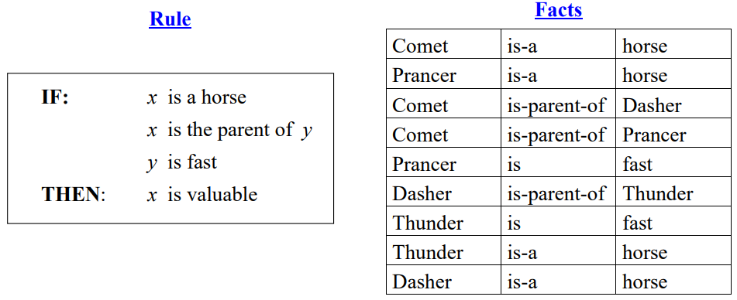
Matching
The condition/premise patterns in the rules need to be matched with the known facts.
Consider, a typical rule (about the value of horses) that matches a set of facts:
In general, variables (e.g. x and y) in the rules which stand for arbitrary objects.
We need to find bindings for them so that the rule is applicable.

Slide 41
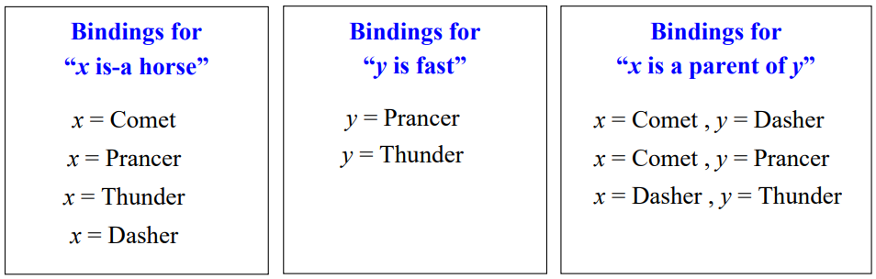
Binding
From these we can deduce that there are two possible bindings applicable to the rule:
x = Comet and y = Prancer
x = Dasher and y = Thunder
The rule then tells us “x is valuable”
Comet is valuable
Dasher is valuable

Slide 42
defrule show-act WM
(a ?x) (a 1)
(b ?x ?y) (b 1 2) (b 2 3) (b 2 4)
(c ?y ?z) (c 3) (c 2)
=> …
Initial state of
RETE Network
show-act
a
c
select
b
a 1
b 1 2
c 3
Resulting relations
(alpha memories)
b 2 3
c 2
b 2 4
Join x
Intermediate partial result
(beta memories)
a 1
b 1 2
Join y
a 1
b 1 2
c 2
Changes to conflict set

Slide 43
Activity of the RETE Match during an Addition
+
a 2
a
c
select
b
a 1
b 1 2
c 3
Resulting relations
(alpha memories)
+
a 2
b 2 3
c 2
b 2 4
Join x
Intermediate partial result
(beta memories)
a 1
b 1 2
+
a 2
b 2 3
+
a 2
b 2 4
Join y
(defrule show-act
(a ?x)
(b ?x ?y)
(c ?y ?z)
=> …
a 1
b 1 2
c 2
+
a 2
b 2 3
c 3
Changes to conflict set

Slide 44
Activity of the RETE Match during a Deletion
-
a 2
a
c
select
b
a 1
b 1 2
c 3
Resulting relations
(alpha memories)
-
a 2
b 2 3
c 2
b 2 4
Join x
Intermediate partial result
(beta memories)
a 1
b 1 2
-
a 2
b 2 3
-
a 2
b 2 4
Join y
(defrule show-act
(a ?x)
(b ?x ?y)
(c ?y ?z)
=> …
a 1
b 1 2
c 2
-
a 2
b 2 3
c 3
Changes to conflict set

Slide 45
Example
PR1: (has-goal ?x simplify), (expression ?x 0 + ?y) ⇒ ....
PR2: (has-goal ?x simplify), (expression ?x 0 * ?y) ⇒ ....
WM:
(has-goal e1 simplicity)
(expression e1 0 + 3)
(has-goal e2 simplicity)
(expression e2 0 + 5)
(has-goal e3 simplicity)
(expression e3 0 * 2)
Has-goal
expression *
expression +
x
=
e1
e2
e3
Y
=
3
5
Y
=
2
x y
====
e3 2
x y
====
e1 3
e2 5
PR2
PR1

Slide 46
Example
PR1: IF (?x is-written-by ?y), A1
(?y is-a science-fiction-writer), A2
(?x is-a book), A3
THEN (?x is-a science-fiction-book) R1-C
WM:
TheDiamondAge is-written-by NealStephenson WilliamGibson is-a science-fiction-writer
Neuromancer is-written-by WilliamGibson PhilipKDick is-a science-fiction-writer
NealStephenson is-a science-fiction-writer PlayerOfGames is-a book
Neuromancer is-a book Ubik is-a book
TheDiamondAge is-a book MazeOfDeath is-a book
MazeOfDeath is-written-by PhilipKDick PlayerOfGames is-written-by IainBanks

Slide 47
Rete Network
x | y
DA | NS
NM | WG
MOD | PKG
POG | IB
Is-written-by
Is-a-sf-writer
y
NS
WG
PKG
Is-a-book
x
NM
DA
POG
UB
MOD
A1
A2
A3
B12
x | y
DA | NS
NM | WG
MOD | PKG
x | y
DA | NS
NM | WG
MOD | PKG
B23
R1-C
x
DA
NM
MOD

Slide 48
Example
PR1: IF (?x is-written-by ?y), A1 PR2: IF (?x is-written-by ?y), A1
(?y is-a science-fiction-writer), A2 (?y is-a science-fiction-writer), A2
(?x is-a book), A3 (?x is-a short-story), A4
THEN (?x is-a science-fiction-book) R1-C THEN (?x is-a science-fiction- short-story) R2-C
WM:
TheDiamondAge is-written-by NealStephenson WilliamGibson is-a science-fiction-writer
Neuromancer is-written-by WilliamGibson PhilipKDick is-a science-fiction-writer
NealStephenson is-a science-fiction-writer PlayerOfGames is-a book
Neuromancer is-a book Ubik is-a book
TheDiamondAge is-a book MazeOfDeath is-a book
MazeOfDeath is-written-by PhilipKDick PlayerOfGames is-written-by IainBanks
BurningChrome is-a short-story BurningChrome is-written-by WilliamGibson
JohnnyMnemonic is-a short-story BluebeardEgg is-a short-story
SecondVariety is-written-by PhilipKDick JohnnyMnemonic is-written-by WilliamGibson
SecondVariety is-a short-story BluebeardEgg is-written-by MargaretAtwood

Slide 49
Rete Network
is-a-short-story
is-written-by
is-a-sf-writer
is-a-book
A4
A1
A2
A3
B12
B12
B23
R2-C
R1-C

Slide 50

Example
Given 2 water jugs, 4 liters and 3 liters. Neither has any measuring marks on it. There is a pump that can be used to fill the jugs. How can you get exactly 2 liters of water into 4-liter jugs?
Consider:
u denote the content of 4L jugs
v denote the content of 3L jugs
WM = {(0, 0)}
Find list of PRs
Solve using:
Forward Changing
Backward Changing

Slide 51
List of PRs
PR 1. (u, v : u <4) → (4, v) Fill the 4L jug
PR 2. (u, v : v <3) → (u, 3) Fill the 3L jug
PR 3. (u, v : u >0) → (u - D, v ) where D is a fraction of the previous content of u.
PR 4. (u, v : v >0) → (u, v - D) where D is a fraction of the previous content of v.
PR 5. (u, v : u >0) → (0, v) Empty the 4L jug
PR 6. (u, v : v >0) → (u, 0) Empty the 3L jug
PR 7. (u, v : u + v ≥ 4 Λ v >0) → (4, v - ( 4 - u)) Pour water from the 3L jug into the 4L jug
until the 4L jug is full
PR 8. (u, v : u + v ≥ 3 Λ u >0) → (u - (3 - v), 3) Pour water from the 4L jug into the 3L jug
until the 3L jug is full.
PR 9. (u, v : u + v ≤4 Λ v >0) → (u + v, 0) Pour all the water from the 3L jug into the 4L jug.
PR 10. (u, v : u + v ≤ 3 Λ u >0) → (0, u + v) Pour all the water from the 4L jug into the 3L jug.

Slide 52
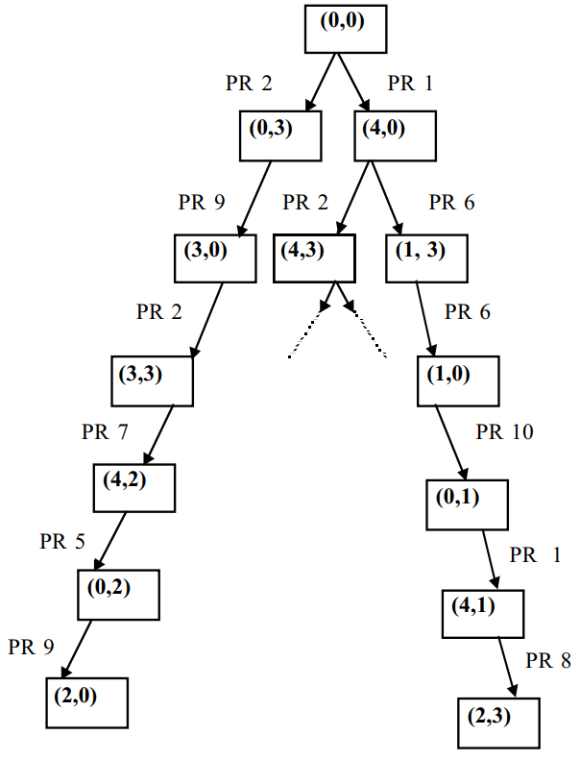
Conflict Resolution Strategies
Where u + v can be brought to 5L or 6L.
Avoid doubling back
never attempt to generate old entries

Slide 53
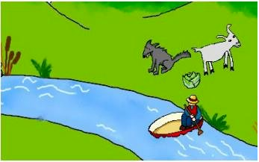
Example
A farmer wants to transfer his three belongings, a wolf, a goat and a cabbage, by a boat from the left bank of a river to its right bank. The boat can carry at most two items including the farmer. If unattended, the wolf may eat up the goat and the goat may eat up the cabbage. How should the farmer plan to transfer the items?
The illegal states: (W,G || F,C) , (G,C || F,W), (F, W || G, C), ( F, C || W, G)
F denote farmer
G denote goat
W denote wolf
|| denote river
WN = WGFC||
Find list of PRs
Solve using:
Forward Changing
Backward Changing

Slide 54
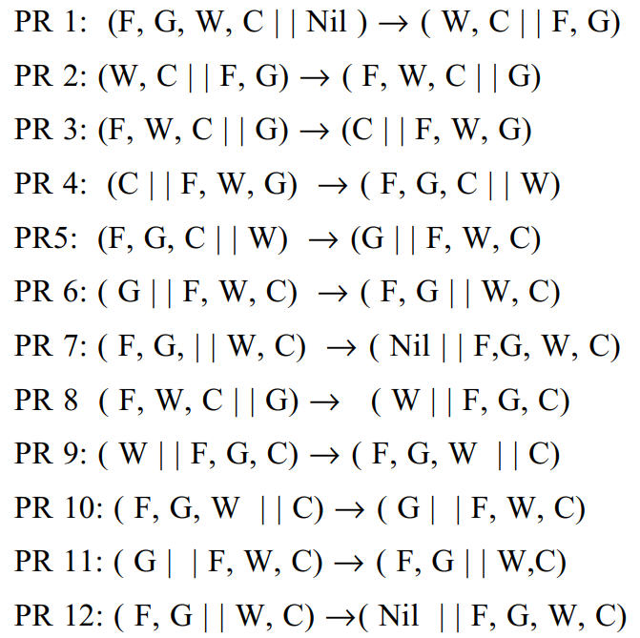
Production Rules

Slide 55
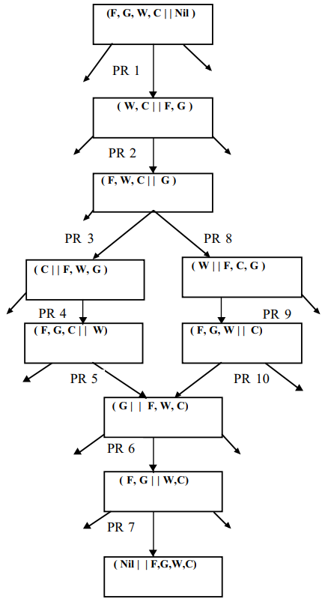
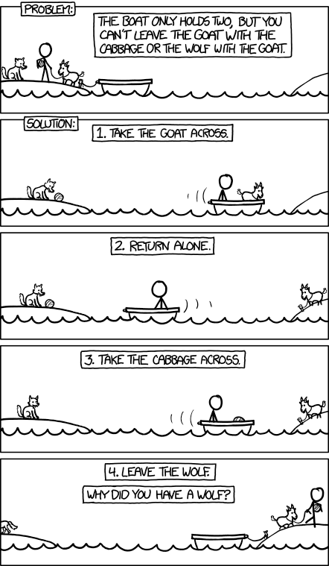

Slide 56
Summery
Production systems are the simplest method for knowledge representation in AI.
Subject-domain Experts, encoding knowledge in simple if-then rules.
The efficiency depends mainly on the order of firing of rules and on the conflict resolution strategies.
Selection of conflict resolution strategies is a significant issue in designing a production system.
Rete Matching Algorithm increase the efficiency of PBS.

